Slide 1
EDA of Movies in OTT platforms
File created on: 6/30/2022 8:17:15 AM

Slide 2
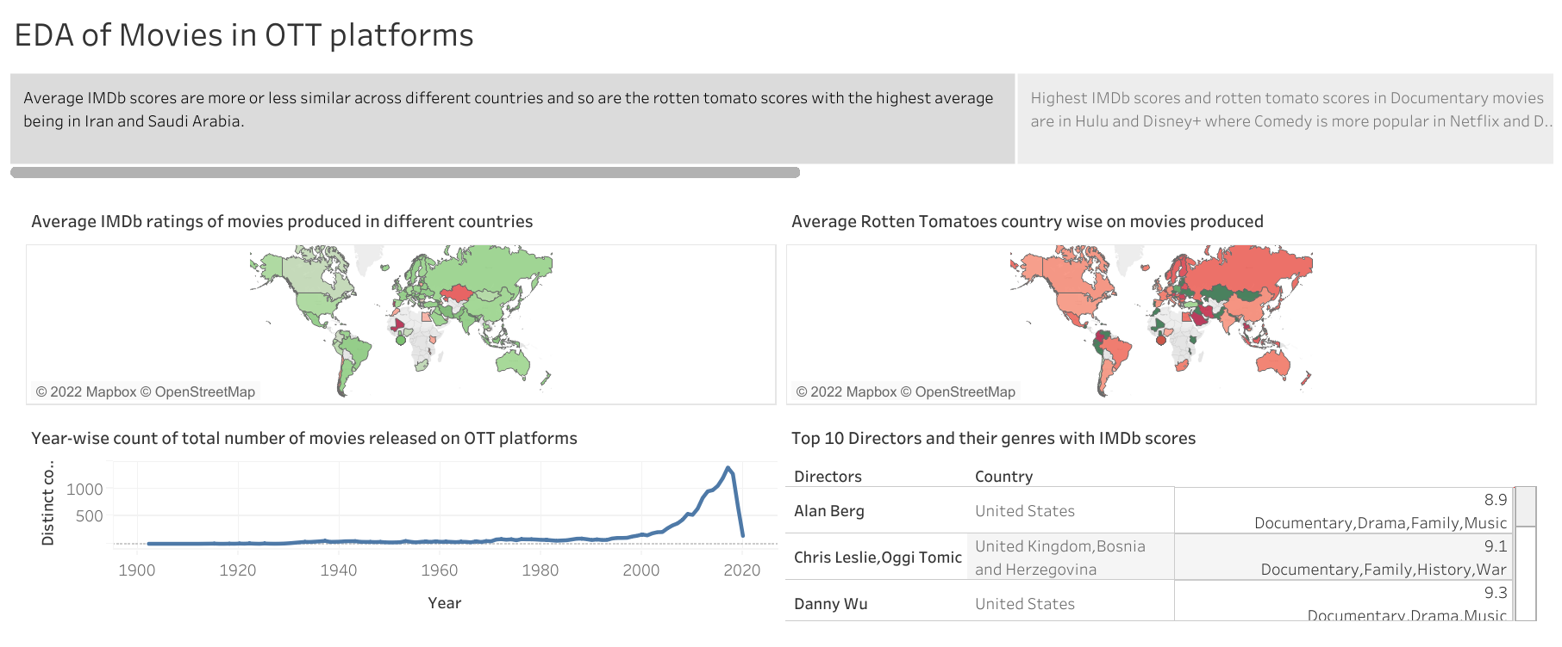

Slide 3
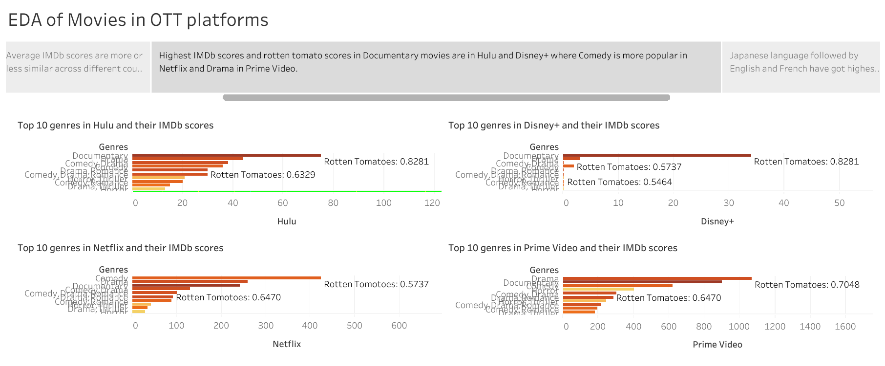

Slide 4
